Slide 1
DETECTION OF OFFENSIVE COMMENTS IN TAMIL: sparse attention mechanism and ensembling strategies on transformers
UNDER THE GUIDANCE OF DR. P VELVIZHY
TEAM MEMBERS:
DHINAKARAN V S - 2019103517
NAVEEN G - 2019103040
PRAVEEN V M - 2019103559

Slide 2
INTRODUCTION
People all over the world using social media to share information and communicate.
Usage of this social media platform may have parallel negative impact on peoples well-being.
These hateful and offensive comments are spread by the toxic users.
If such toxic behaviour is not addressed in a timely manner, it can have a cascading effect and discourages other people from being involved in online community.
Offensive language detection is not available for low resource languages like Tamil. So our system uses deep learning techniques and transformer models to identify offensive Tamil comments.

Slide 3
OVERALL OBJECTIVE
The main objective is to identify the offensive content in Tamil posted on social media platforms, YouTube comments and so on.
Use multilingual transformer models which performs cross-lingual transfer learning to identify offensive language of code-mixed text in Tamil language.
We use sparse attention mechanism to increase the performance of the transformer models and ensemble of transformer models to give the final optimized model.

Slide 4
LITERATURE SURVEY
S.NO | BASE PAPER | METHODOLOGY | ISSUES
1. | Gaydhani, A., Doma, V., Kendre, S., Bhagwat, L., 2018. Detecting hate speech and offensive language on twitter using machine learning: An n-gram and tfidf based approach. | An approach to automatically classify tweets on Twitter into three classes: hateful, offensive and clean. | Require a well defined feature extraction strategy.
2. | Dave, B., Bhat, S., Majumder, P., 2021. Irnlp_daiict @ dravidianlangtech-eacl2021: offensive language identification in Dravidian languages using TF-IDF char n-grams and MuRIL. In: Proceedings of the First Workshop on Speech and Language Technologies for Dravidian Languages | Classified the YouTube comments in Tamil, Malayalam, and Kannada into five classes using LR and linear SVM models. | It uses traditional ML classifiers which works best in English alone.

Slide 5
LITERATURE SURVEY
S.NO | BASE PAPER | METHODOLOGY | ISSUES
3. | Dowlagar, S., Mamidi, R., 2021. Hasocone@ fire-hasoc2020: Using BERT and multilingual BERT models for hate speech detection. | An approach to automatically classify hate speech and offensive content. | Number of parameters to train is very large.
4. | Priyadharshini, R., Chakravarthi, B.R., Chinnaudayar Navaneethakrishnan, S., Durairaj, T., Subramanian, M., Shanmugavadivel, K., U Hegde, S., Kumaresan, P.K., 2022. Findings of the shared task on abusive comment detection in tamil. In: Proceedings of the Second Workshop on Speech and Language Technologies for Dravidian Languages. Association for Computational Linguistics. | A comment/post-level classification task. Given a YouTube comment, the systems submitted by the participants should classify it as abusive categories. | Fail to classify the sentences whenever the sentences contain only the English transliterated words

Slide 6
LITERATURE SURVEY
S.NO | BASE PAPER | METHODOLOGY | ISSUES
5. | Nayel, H.A., Shashirekha, H., 2019. Deep at HASOC2019: A machine learning framework for hate speech and offensive language detection. In: FIRE (WorkingNotes). pp. 336–343. | Hate Speech and Offensive Content Identification for three languages namely, English, Germany and Hindi. | uses less effective ML models and it is not developed for low resourced languages like tamil.
6. | Ayo, F.E., Folorunso, O., Ibharalu, F.T., Osinuga, I.A., 2020. Machine learning techniques for hate speech classification of twitter data: State-of-the-art, futurechallenges and research directions. Comput. Sci. Rev. 38, 100311. | An approach to automatically classify tweets on Twitter into three classes: hateful, offensive and clean. | issues of generic metadata architecture, scalability, class imbalance data, threshold settings and fragmentation.

Slide 7

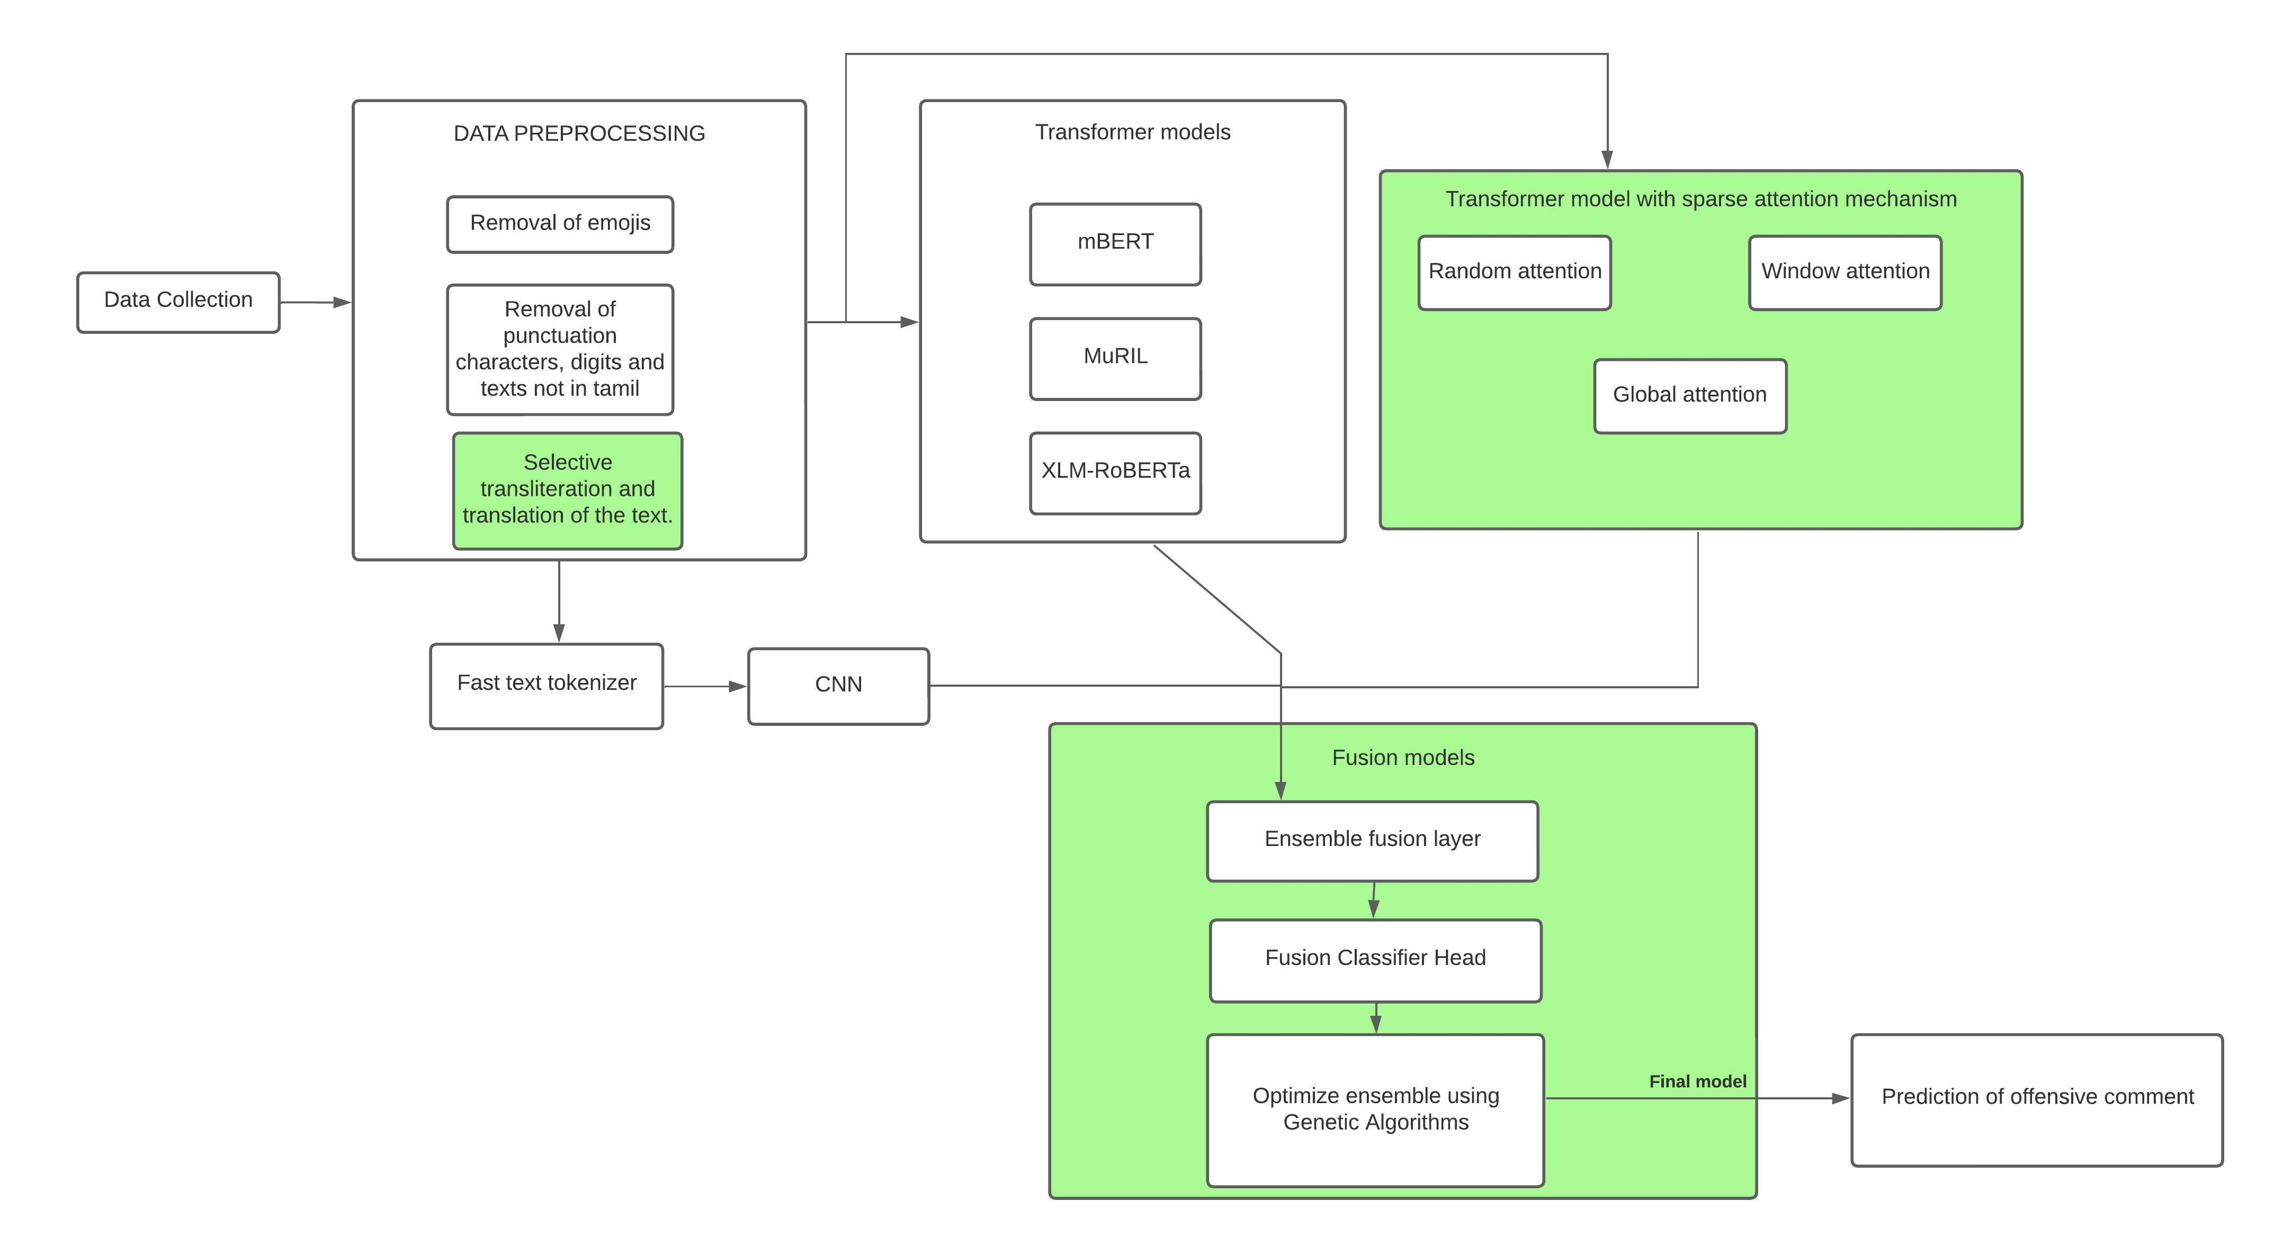
BLOCK DIAGRAM

Slide 8
LIST OF MODULES
The List of modules involved in the entire processes are as follows:
Data Pre-processing
Transformer Models
Transformer Model with Sparse Attention Mechanism
Fusion Models

Slide 9
Data pre-processing
Converting raw data into a format which are clean is essential so that the NLP models can understand.
We remove unwanted data from the corpus such as emojis, punctuation characters and words that were not in Tamil so that the rest of the data could be processed properly.
Emojis can be removed by substituting equal textual form of that emoji or by removing them altogether as they do not generally convey any semantic value.
Punctuation characters such as !,?,etc and numerical digits by removing them completely as they do not serve our classification goal.
Romanized script is converted into native script so that it can be trained on multiple transformer architectures.
The cross-lingual nature of the transformer-based models are used to efficiently handle these types of mixed script sentences.

Slide 10
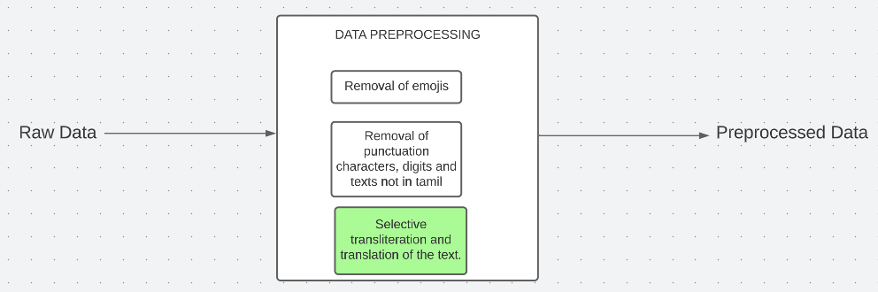
Data pre-processing
INPUT: Raw data
OUTPUT: Pre-processed data

Slide 11
transformer Models
mBERT: An open source machine learning framework for natural language processing (NLP)which is designed to help computers understand the meaning of ambiguous language in text by using surrounding text to establish context.
muRil: Latest multilingual model launched by Google and is aimed at improving interoperability from one language to another.
XLM-ROBERTa: A self-supervised transformer model which uses the MLM technique without the Next Sentence Prediction(NSP) technique. Entails sampling streams of text from various languages and masking some tokens so that it can anticipate the missing tokens.

Slide 12
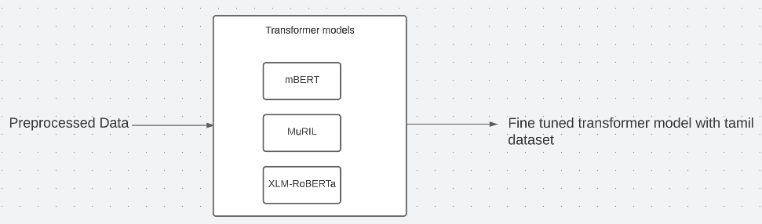
transformer Models
INPUT: Preprocessed data
OUTPUT: Fine tuned transformer model with Tamil dataset

Slide 13
Sparse attention mechanisms
Random Attention: The attention weights are generated in a random manner for a subset of the input tokens, rather than computing attention for all tokens..
Window Attention: The model will attend to a fixed-size window of source tokens around the target token being translated, rather than attending to the entire source sentence
Global Attention: The model attends to all input tokens, rather than a subset of them. This considers entire input when making predictions for text classification.

Slide 14
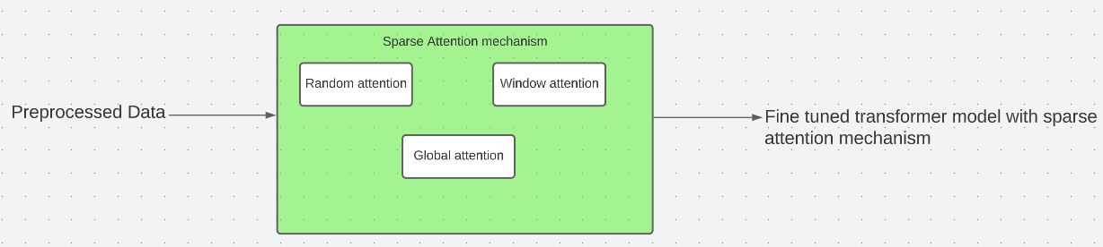
Sparse attention mechanisms
INPUT: Preprocessed data
OUTPUT: Fine tuned transformer model with sparse attention mechanism

Slide 15
FUSION MODELS
Train a single classification head on the concatenated embeddings from different BERT,CNN models and sparse attention transformers.
BERT models were initialized with the fine-tuned weights in the former section and the weights were frozen.
reduce the influence of weak models is using weights for BERT,CNN and sparse attention transformer models based on their performance.
Genetic algorithm (GA) based technique is used to set the weights of different models in an ensemble.
In this strategy instead of selecting the models with the highest weights for the final ensemble, we directly use the weights to compute the weighted average ensemble.

Slide 16
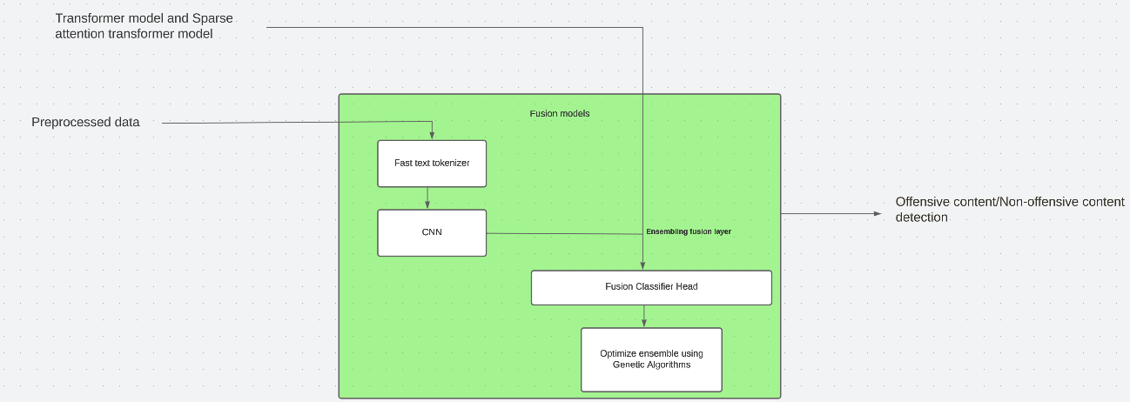
Fusion models
INPUT: Fine-tuned Transformer models, CNN, Sparse attention transformer models
OUTPUT: Offensive content/Non-offensive content detection

Slide 17
PERFORMANCE MEASURES
Accuracy
𝐴𝑐𝑐𝑢𝑟𝑎𝑐𝑦 = (𝑇 𝑃 + 𝑇𝑁)/(𝑇 𝑃 + 𝑇𝑁 + 𝐹𝑃 + 𝐹𝑁)
Recall
𝑅𝑒𝑐𝑎𝑙𝑙 = 𝑇 𝑃/(𝑇 𝑃 + 𝐹𝑁)
Precision
𝑃𝑟𝑒𝑐𝑖𝑠𝑖𝑜𝑛 = 𝑇 𝑃/(𝑇 𝑃 + 𝐹𝑃)
F1-score
𝐹1𝑠𝑐𝑜𝑟𝑒 = (2 − 𝑃𝑟𝑒𝑐𝑖𝑠𝑖𝑜𝑛 − 𝑅𝑒𝑐𝑎𝑙𝑙)/(𝑃𝑟𝑒𝑐𝑖𝑠𝑖𝑜𝑛 + 𝑅𝑒𝑐𝑎𝑙𝑙)

Slide 18
DATASET
Dataset used in the project is
Dravidian Code-Mix FIRE 2021

Slide 19
REFERENCES
[1] Malliga Subramanian a, Rahul Ponnusamy b, Sean Benhur c, Kogilavani Shanmugavadivel a, Adhithiya Ganesan a, Deepti Ravi a, Gowtham Krishnan Shanmugasundaram a, Ruba Priyadharshini d,Bharathi Raja Chakravarthi e Offensive language detection in Tamil YouTube comments by adapters and cross-domain knowledge transfer.
[2] Gaydhani, A., Doma, V., Kendre, S., Bhagwat, L., 2018. Detecting hate speech and offensive language on twitter using machine learning: An n-gram and tfidf based approach. arXiv preprint arXiv:1809.08651.
[3] Dave, B., Bhat, S., Majumder, P., 2021. Irnlp_daiict @ dravidianlangtech-eacl2021: offensive language identification in Dravidian languages using TF-IDF char n-grams and MuRIL. In: Proceedings of the First Workshop on Speech and Language Technologies for Dravidian Languages, pp. 266–269.
[4] Dowlagar, S., Mamidi, R., 2021. Hasocone@ fire-hasoc2020: Using BERT and multilingual BERT models for hate speech detection. arXiv preprint arXiv:2101.09007. Gao, L., Huang, R., 2017. Detecting online hate speech using context aware models. arXiv preprint arXiv:1710.07395.
[5] Priyadharshini, R., Chakravarthi, B.R., Chinnaudayar Navaneethakrishnan, S., Durairaj, T., Subramanian, M., Shanmugavadivel, K., U Hegde, S., Kumaresan, P.K.,2022. Findings of the shared task on abusive comment detection in tamil. In: Proceedings of the Second Workshop on Speech and Language Technologies for Dravidian Languages. Association for Computational Linguistics.

Slide 20
references
[6] Charangan Vasantharajan, Uthayasanker Thayasivam :Towards Offensive Language Identification for Tamil Code-Mixed YouTube Comments and Posts.
7] Hande, A., Puranik, K., Yasaswini, K., Priyadharshini, R., Thavareesan, S., Sampath, A., Shanmugavadivel, K., Thenmozhi, D., Chakravarthi, B.R., 2021. Offensive language identification in low-resourced code-mixed dravidian languages using pseudo-labeling. arXiv preprint arXiv:2108.12177.
[8] Manzil Zaheer, Guru Guruganesh, Avinava Dubey, Joshua Ainslie, Chris Alberti, Santiago Ontanon, Philip Pham, Anirudh Ravula, Qifan Wang, Li Yang, Amr Ahmed. Big Bird: Transformers for Longer Sequences
[9] Debjoy Saha , Naman Paharia , Debajit Chakraborty, Punyajoy Saha, Animesh Mukherjee:Hate-Alert@DravidianLangTech-EACL2021: Ensembling strategies for Transformer-based Offensive language Detection

